Slide 1


LORENA QUIROGA
BEA MASTER STUDENT
1ST YEAR
ON THE PSYCHOLOGY OF POVERTY
JOHANNES HAUSHOFER & ERNST FEHR
MAY, 2014

Slide 2
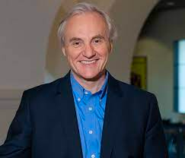



AUTHORS
Ernst Fehr
Professor and Director of the UBS Center for Economics in Society at University of Zurich.
Experimental, Behavioral and Neuroeconomics
Johannes Haushofer
Professor of Economics at Stockholm University
Prize Fellow in Economics.
Advisors: Esther Duflo, Abhijit Banerjee

Slide 3
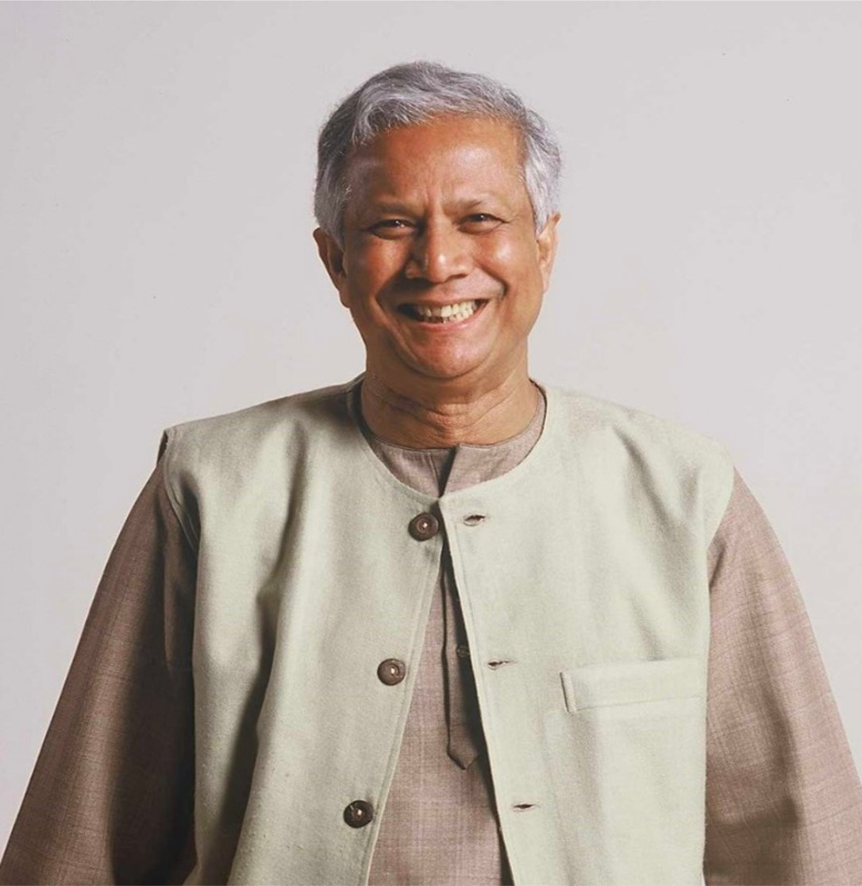


REMARKS ON POVERTY
Monetary poverty
Insufficient income.
World Bank >$1/day (PPP to 2013).
Environment effects on poverty
Dysfunctional Institutions
Exposure to violence & crime
Poor access to health care
Obstacles & Inconveniences
Additional remarks on poverty
Environments of poverty as starting point can trigger processes reinforcing poverty.
Access to formal credit markets-> Liquidity Constrained

Slide 4

RESEARCH MOTIVATION
Does poverty affect people’s affective states and stress, and that this effect may change people’s behaviorally revealed preferences?
Stress and negative affective states turning short-sighted and risk-averse decision-making.

Slide 5


01
02
03
EFFECT OF POVERTY ON RISK-TAKING AND TIME-DISCOUNTING
EFFECT OF POVERTY ON AFFECT AND STRESS
EFFECT OF NEGATIVE AFFECT AND STRESS ON RISK-TAKING AND TIME-DISCOUNTING
Poverty has a causal effect on risk-taking and time-discounting.
Liquidity constraints:
Choice between a current and delayed payment--> current payment.
Psychological well-being measure with happiness and life satisfaction Q’s from World Values Survey
Stress & Depression from Cohen’s Perceived Stress Scale.
Credit constraints & uninsurable background risks---> vulnerable to income and health shocks.

Slide 6





POVERTY ON AFFECT & STRESS
Randomized Field Experiments (-)
Natural Experiments (-)
Unexpected Shocks (+)
Unconditional cash transfer program in Kenya
Transfers of $0, $400, or $1500.
N=1440 poor households in Kenya
“How happy are you with your life as a whole these days? (1-10 scale)
Happiness Responses measured 1 year after the program.
Guaranteed inocomes
Lottery Payouts
Access to Pension schemes
Native Americans’ payouts from a casino opening.
Increase in income lead to:
-Reduction in hospitalization for mental health problems
-Lower consumption on anxiolytics
-Increase in self-reported mental health.
Spells of bad weather for farmers.
Higher levels of cortisol and self-reported stress during drought periods.
Agriculture-dependent.

Slide 7
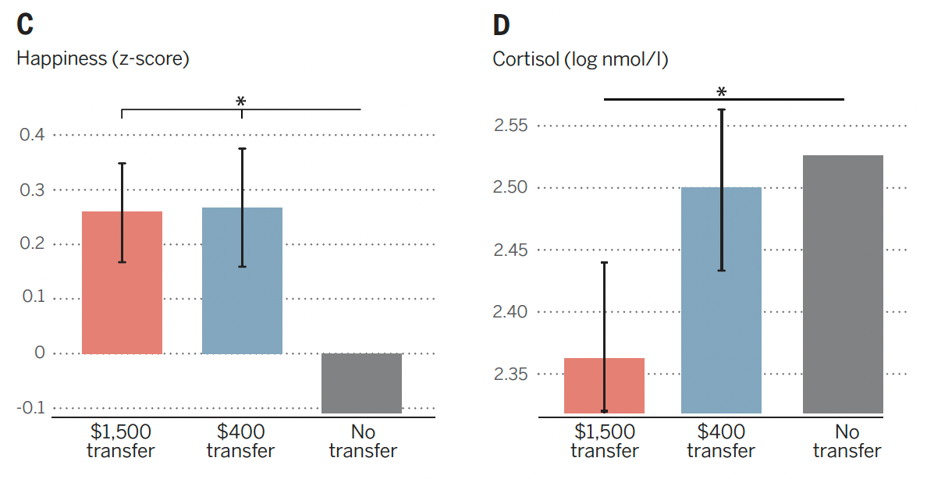
EFFECTS OF POVERTY ON AFFECT AND STRESS
Unconditional Cash Transfer
Randomized Field Experiment
J. Haushofer, J. Shapiro, Household response to income
changes: Evidence from an unconditional cash transfer
program in Kenya. Massachusetts Institute of Technology
Working Paper (2013); available at http://web.mit.edu/joha/
www/publications/haushofer_shapiro_uct_2013.11.16.pdf

Slide 8
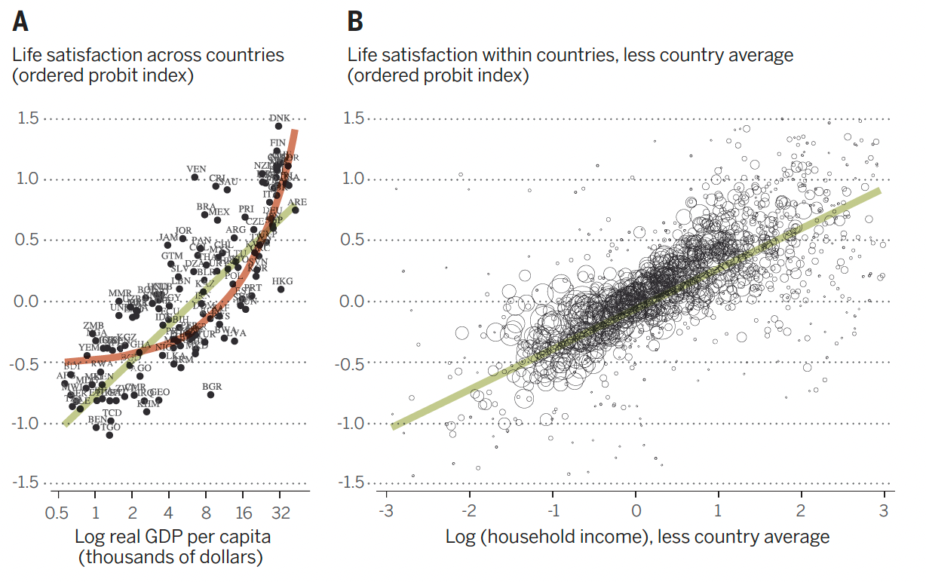
EFFECTS OF POVERTY ON AFFECT AND STRESS
Income and Life Satisfaction
Gallup World Poll
Notes:
-102 583 respondents
-131 countries
-"Please imagine a ladder with steps numbered from 1 to 0 at the bottom to ten at the top...etc, on which step of the ladder would you say you personally feel you stand at this time?
-PPP 2000 international dollars
-B) each circle represents one income bracket in one country. Diameter is proportional to the population of the income category in the country

Slide 9

EFFECTS ON RISK TAKING
Placebo-controlled hydrocortisone administration.
Acute (day 1)
Chronic (Subsequent days)
Chronic led to strong increases in risk-aversion vs. acute.
Threat of Electrical Shocks (unpredictable)
High threat->High Risk-aversion
Exogenously induced fear.
Horror film-> Higher risk-aversion
*Induced emotions must be continuously sustained otherwise emotional effect is short-lived
STUDY 3
STUDY 1
STUDY 2

Slide 10
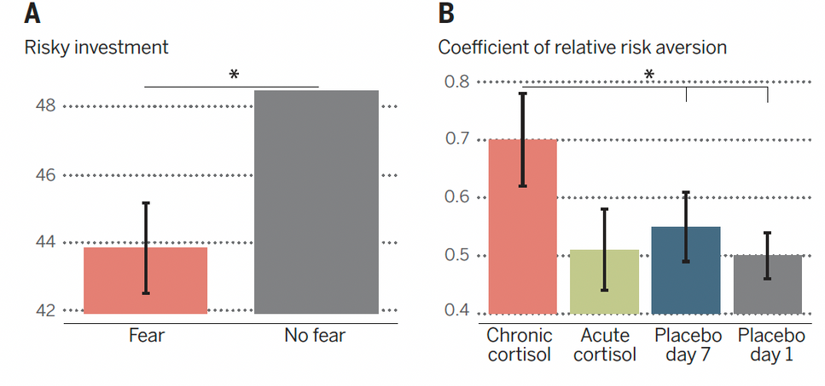
N. Kandasamy et al., Proc. Natl. Acad. Sci. U.S.A. 111,
3608–3613 (2014).
EFFECTS ON RISK TAKING
N. Kandasamy et al., Proc. Natl. Acad. Sci. U.S.A. 111,
3608–3613 (2014).

Slide 11
EFFECTS ON TIME-DISCOUNTING
Material Scarcity changing people’s allocation of attention and effect on performance.
Sadness Induction
Smaller amount of money immediately
vs.
Larger amounts after a delay
Decision Making under scarcity.
Cognitive control and intelligence-measuring tasks
Questions about Finances
Farmers before the harvest.
REMARKS
STUDY 1
STUDY 2

Slide 12
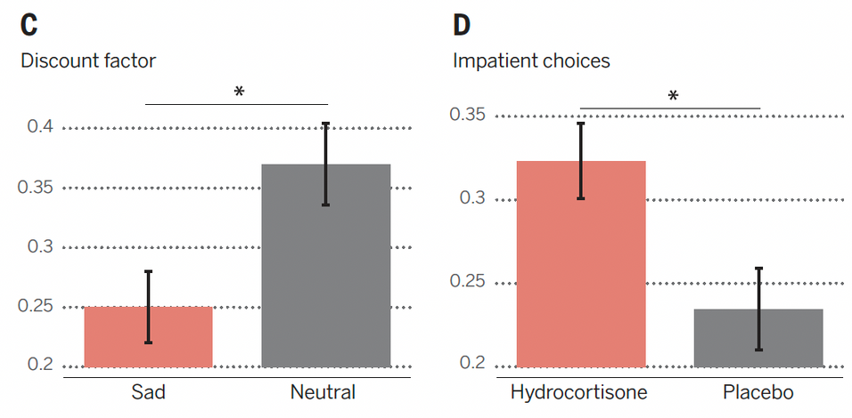
N. Kandasamy et al., Proc. Natl. Acad. Sci. U.S.A. 111,
3608–3613 (2014).
EFFECTS ON RISK TAKING
J. S. Lerner, Y. Li, E. U. Weber, Psychol. Sci. 24, 72–79
(2013).
S. Cornelisse et al., Time-dependent effect of hydrocortisone
administration on intertemporal choice. SSRN Working Paper
Series (2013);

Slide 13
EMERGING ISSUES
Weakest Link
Between poverty-pshychological outcomes-economic choice
Effect of stress and negative affect on economic choice
Currently restricted to laboratory studies
Temporal Dimension
Poverty alleviation leads to permanently or only a temporary increase in psychological well-being?
Welfare programs and interventions
Target poverty directly
Target psychological consequences
Target Economic Behaviors
Studied in isolation.

Slide 14


THANK'S FOR WATCHING

